Slide 1
Where to play?

Slide 2
Introduction/Business Problem
A client wants to open a Pancakes restuarant in Amsterdam and asked to help answering the question, 'Where to open the new restaurant?’.
The target costumers of the restaurant are mainly tourists and it is therefore important to open the restuarant at a place where a lot of people pass.

Slide 3
Data
To find these popular places, the explore endpoint of the Foursquare API can be used. The data that is eventually used contains the most popular places in Amsterdam including the category of the venue and the popularity ranking.

Slide 4
Methodology
In order to find the optimal place to start a new restaurant, the analysis will focus on two key metrics. The first thing to investigate is which are the most popular spots in amsterdam. This will be investigated by mapping the most popular venues in the city. Secondly, it will be assessed where competitors are situated. The two analyses will be combined to find the optimal spots to open the new pancake restrant.

Slide 5
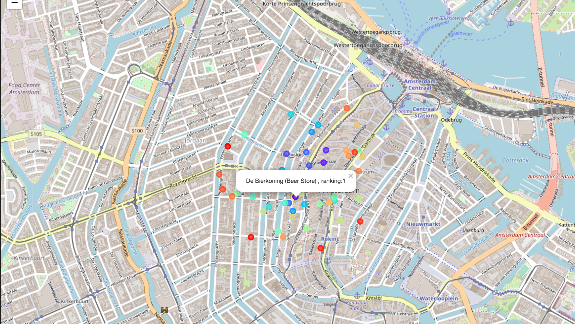
Results
The map below shows us the following 2 thing:
The most popular venues are situated in the Centre (Dam square) and Wester Grachtengordel of Amsterdam.
There seem to more competitors (in the category restaurants) in the area of Wester Grachtengordel than in the Centre (Dam square)

Slide 6
Conclusion
Based on both the popularity of venues as well as the amount of competitors per area, the Centre (Dam square) seems to be the optimal spot in Amsterdam to open a new pancake restaurant. One of the drawbacks of the method is that the rent price of the different locations is not taken into account.

